Slide 1
Tablet
Alpha Prototype
Diogo, Lio, Ray, Jose, Sam and Cameron

Slide 2
Road Map
Challenge Overview
Mechanical Design Overview
Mechanical Design Focus Areas
Control System
Notes:
Cam

Slide 3
Challenge Overview
Move 2 points around in a plane
Provide force to user through magnet
User can interact with various virtual objects through display
Robot can track location of 1 or 2 fingers
Notes:
Cam

Slide 4
Technical Requirements
Continuous 6N at the end effector
Moving speed up to 150 mm/s
Wall stiffness of 1N/mm
Notes:
Cam

Slide 5
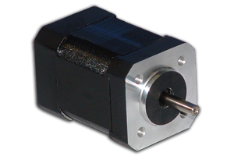
Design Focus: Motor Selection
BLY172D-24V-2000 from Anaheim Automation
Continues torque 0.2N-m
Torque const. 0.055 N-m/A
Continuous speed 2000 rpm
Motor inertia 48.018472 g-cm2
Notes:
Ray

Slide 6
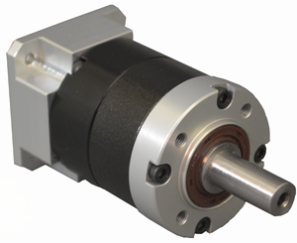
Design Focus: Gearbox Selection
GBPS-0401-CS-005 from Anaheim Automation
Gear ratio: 5:1
Continuous output torque: 8 N- m
Max input speed 6000 rpm
Backlash 0.1 degree
Efficiency 95%
(4:1 out of stock)
Notes:
Ray

Slide 7
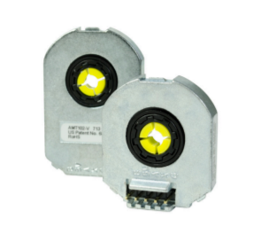
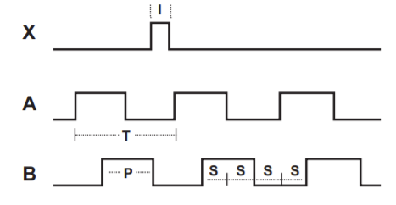
Design Focus: Encoder Selection
AMT102-V from CUI Devices
Quadrature resolutions 2048 PPR(Pulses Per Revolution)
Counts Per Revolution 2048*4
Creates linear resolution of 28 μm at end effector
Notes:
Ray/Cam/Lio

Slide 8
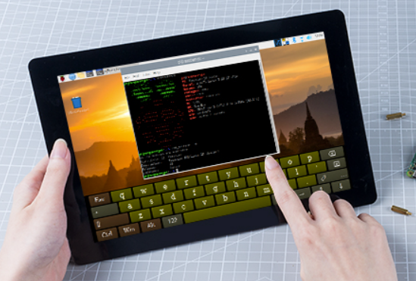
Design Focus: Tablet
10” x 7” Display
Plan to run tablet off of Raspberry Pi, but can move to Android OS with same tablet
Refresh rate currently unknown-will characterize
Notes:
Cam

Slide 9
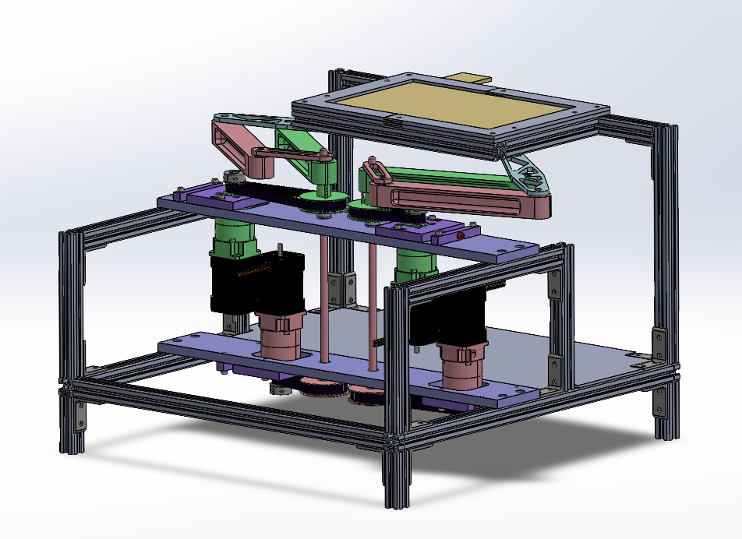
Design Overview
All motors fixed on the frame
Symmetric 2R linkages to create 4DOF
80/20 Frame
Notes:
Jose

Slide 10
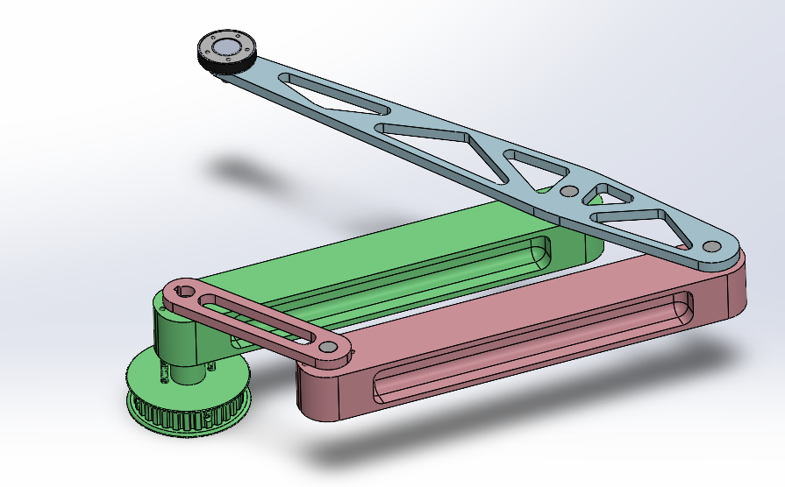
Design Focus: Arms
Parallel ‘phantom’ linkage
Machined aluminum links
Total mass 0.6 kg
Press fit bearings in base links
Performs well across majority of workspace
Performs poorer near edges of workspace
Notes:
Jose

Slide 11
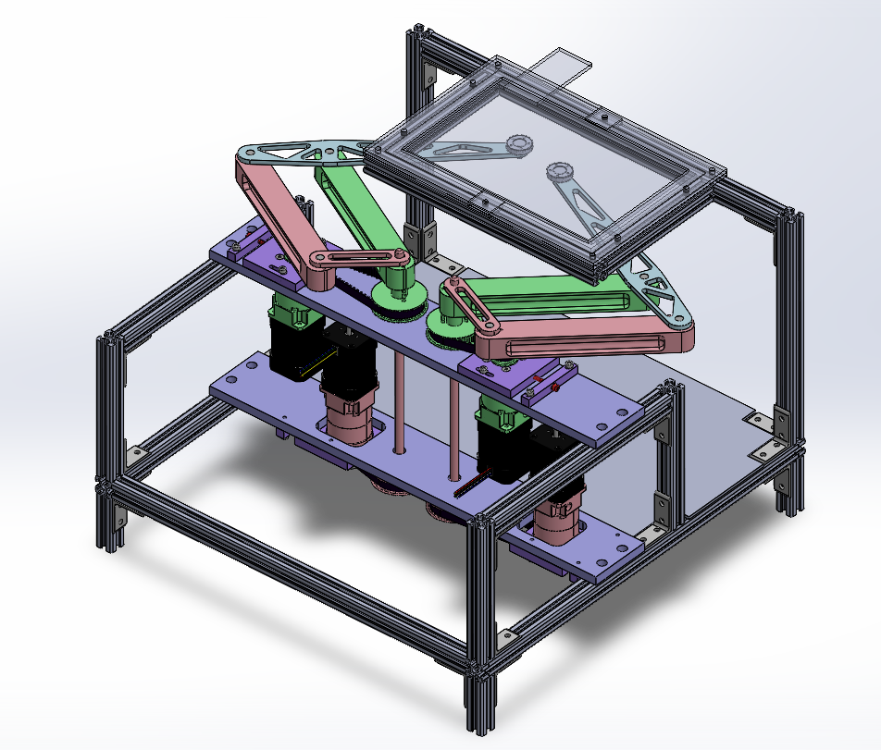
Design Focus: Transmission
Combined planetary gearbox and belt system
Gearbox reduction = 5:1
Pulley reduction = 2.5:1
Reduces projected backlash from gearbox
Continuous output torque: 2.46 N-m
Minimum feasible output force: 8.52 N
Notes:
Sam

Slide 12
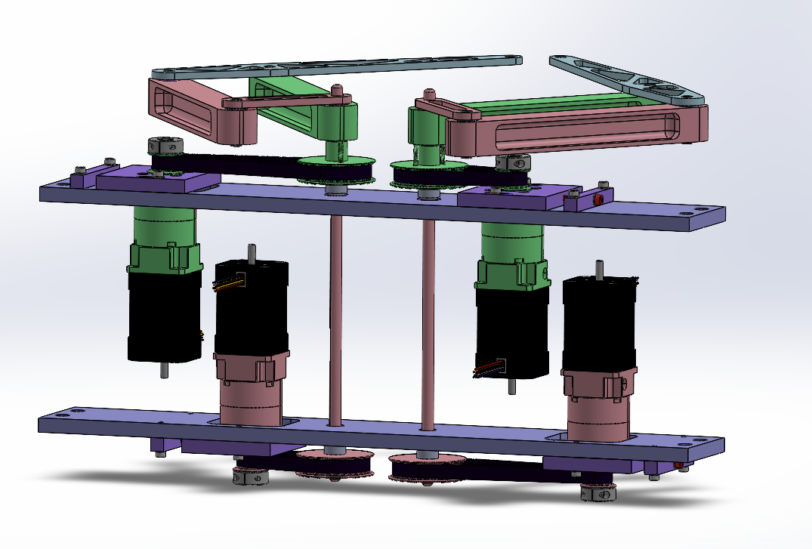
Design Focus: Transmission
Friction fit keys
Keyed pulleys and connecting link
XL Belt profile
All shafts mounted with 2 roller bearings
Notes:
Sam

Slide 13
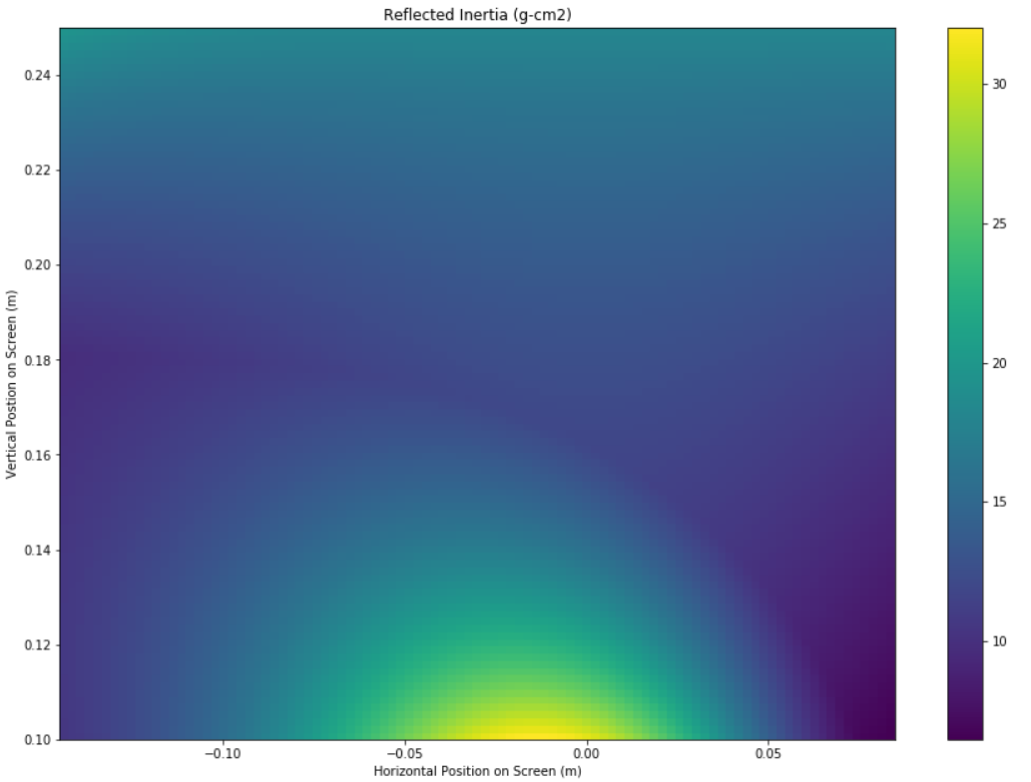
Design Focus: Transmission
Maximum projected backlash at end effector: 0.31 mm
Absorbed by magnetic coupling
Maximum reflected inertia at end effector: 32.0 g-cm²
Concentrated in one location
Notes:
Sam

Slide 14
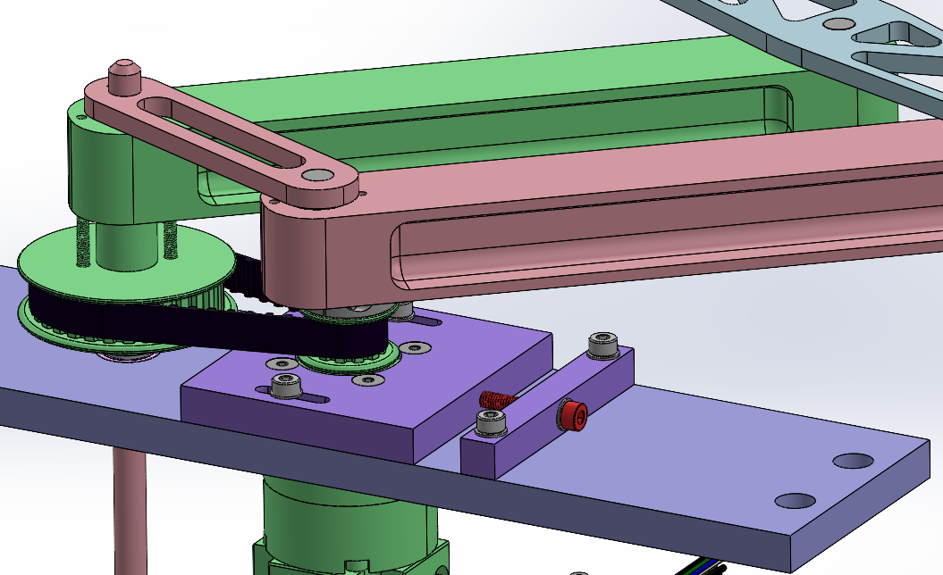
Design Focus: Belt Tensioning
Gearboxes mounted to slotted sled
Tighten red screw to set distance and tension in belt
Notes:
Sam

Slide 15
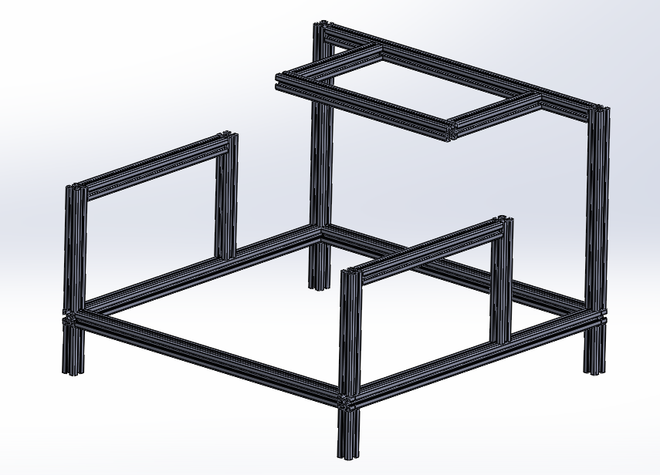
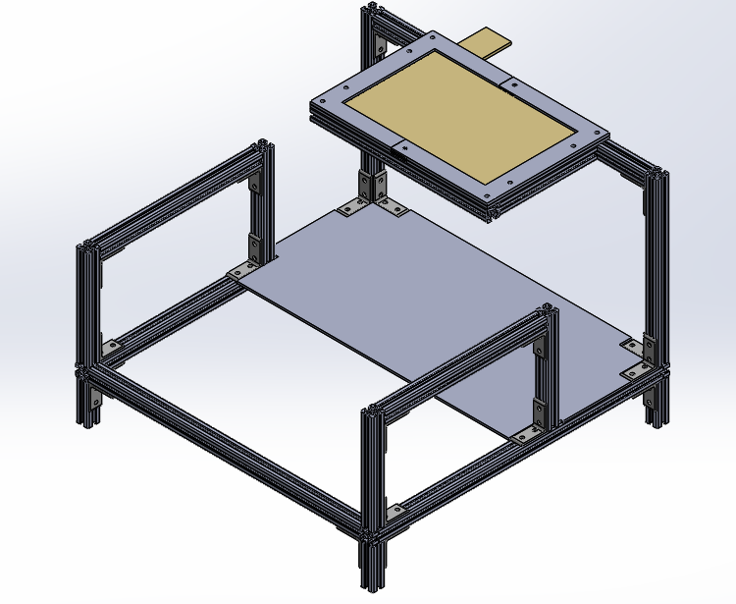
Design Focus: Base
20mm rail 80/20 Construction
Off the shelf components
Mounts robot and all electronics
Notes:
Jose

Slide 16
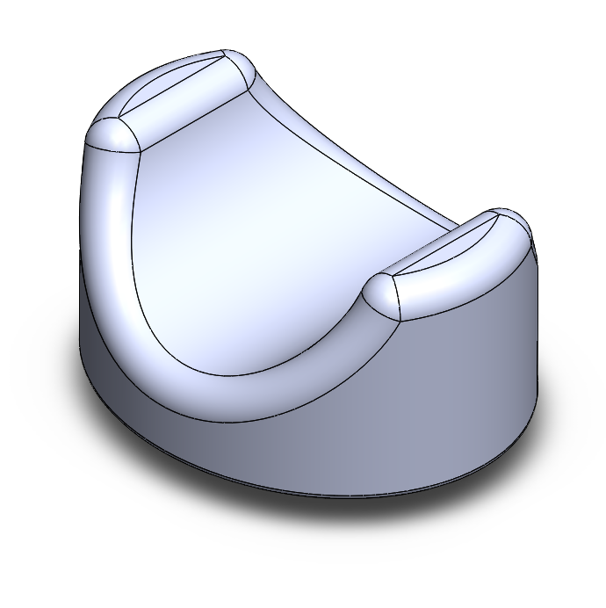
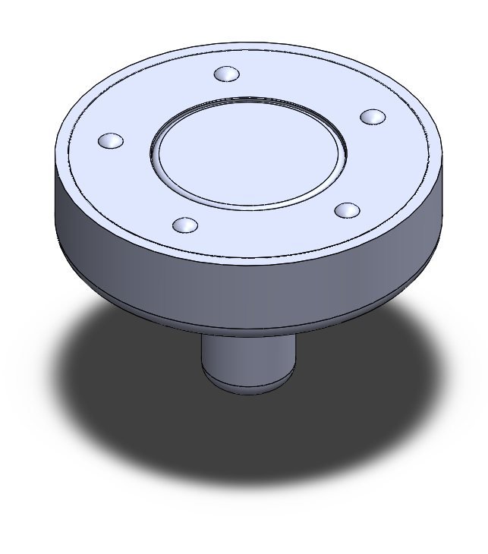
Design Focus: Magnet
LOW FRICTION:
In free motion, the user should experience no more than 0.22 lbs or 100 g of inertia.
Match finger speeds up to 150mm/s or 5.9 in/s
HIGH SHEAR STRENGTH:
When the user is interacting with a virtual wall, the device will be able to respond with a stiffness of 1 N/mm or 5.71 lbs/in
Notes:
Diogo

Slide 17
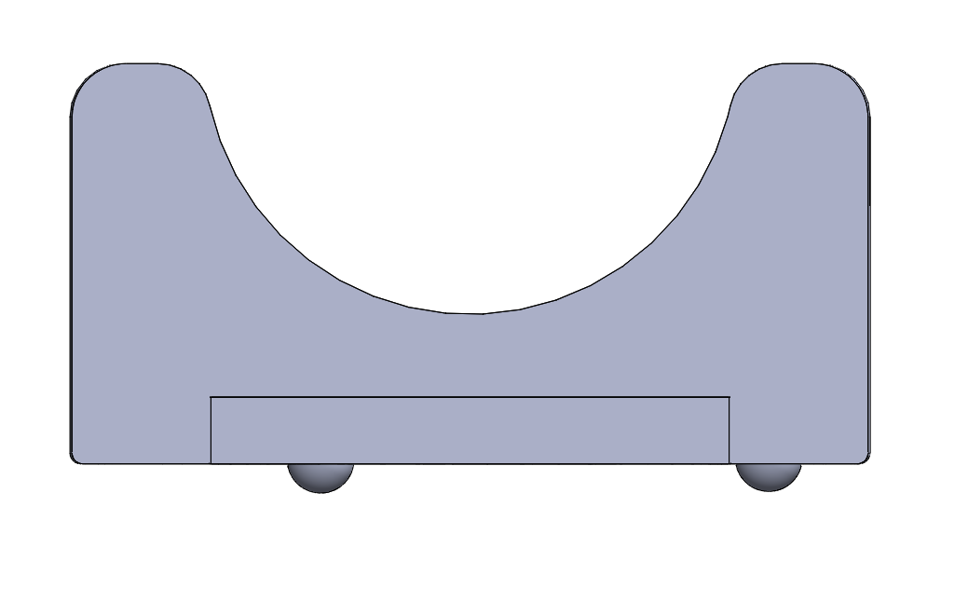
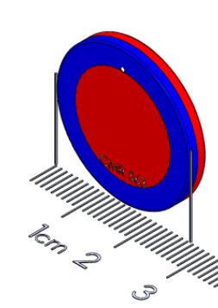
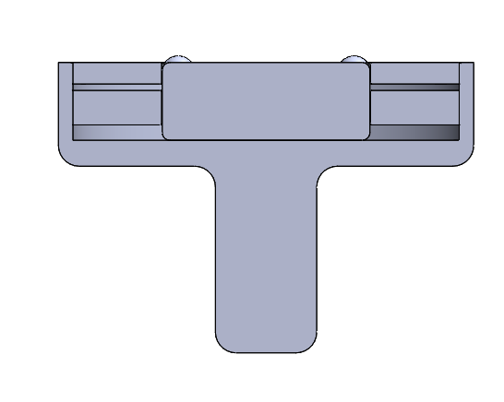
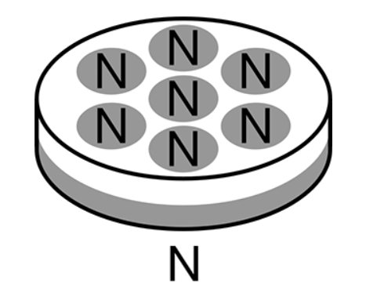
Design Focus: Magnet
The current design uses two different polymagnets:
The one on top has 1 inch diameter and a concentric magnet design
The bottom one has ½ inch diameter and the poly-magnetism is created by 7 smaller circles of opposing magnetism
For future, we may integrate an air bearing
Notes:
This were so far the ones that gave me a decent shear when including the thrust bearings Diogo

Slide 18
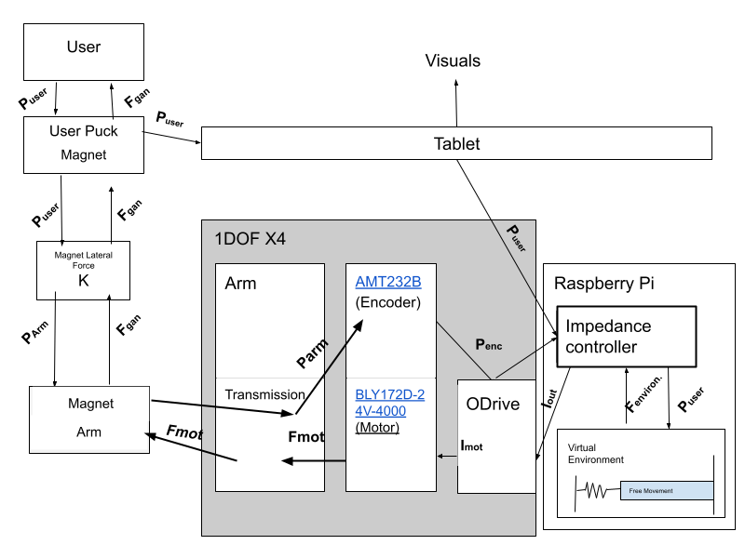
Control System Architecture
Notes:
Cam

Slide 19
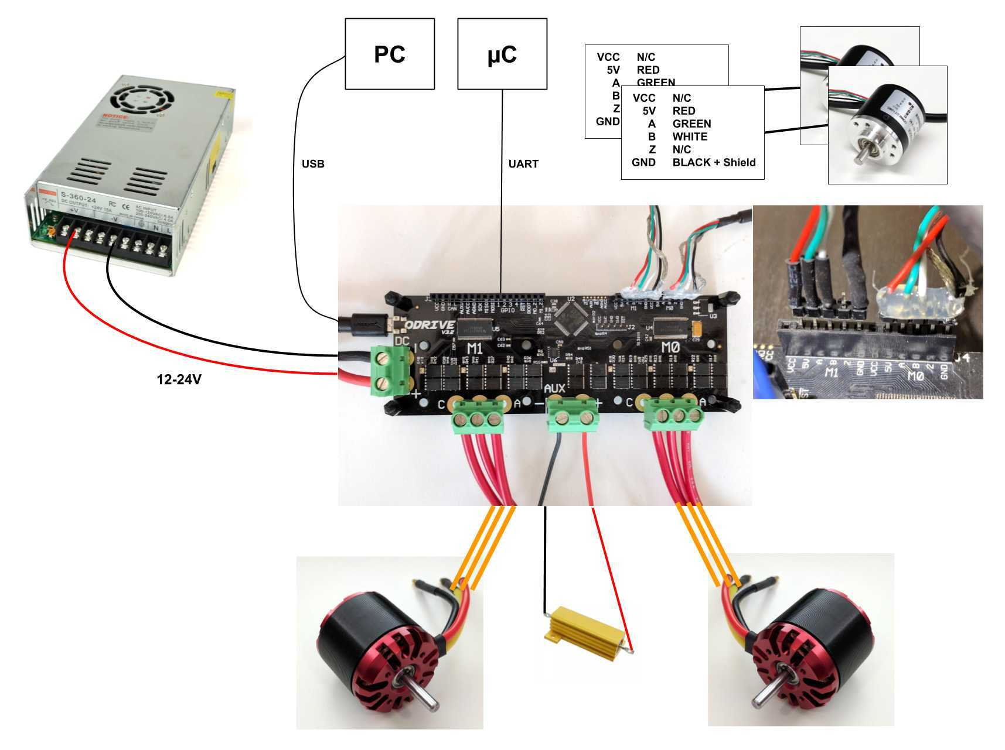
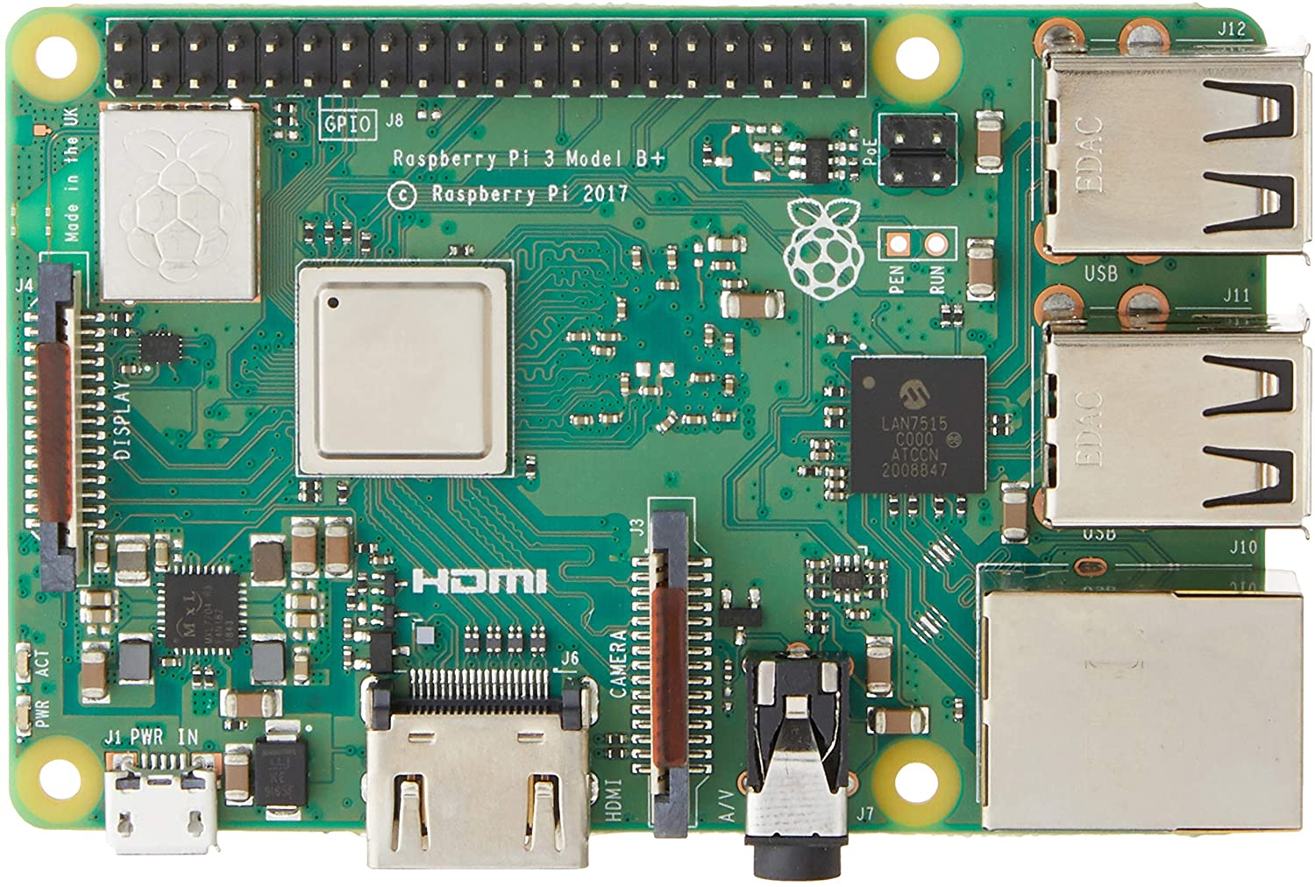
Control System - Wiring Diagram(Only 1 Odrive shown)
Notes:
Cam

Slide 20
Control System: Communication
Using UART communication through Raspberry Pi and Odrive
The frequency by using serial port from Raspberry Pi is approximately 800 Hz which increase 33 % from using computer
With latency 0.2 ms to 1 ms depends on the character we send from Raspberry Pi to Odrive
Notes:
Cam

Slide 21
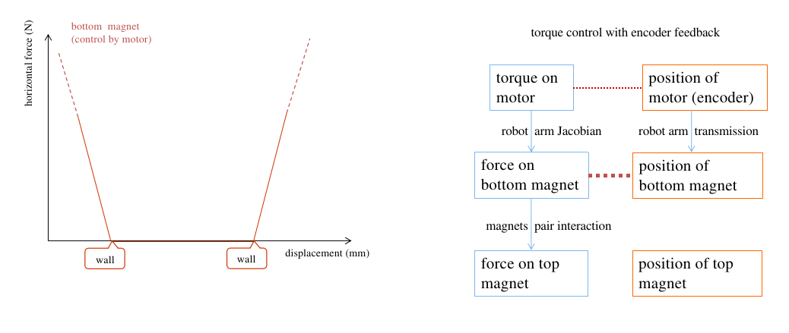
Control System: Control Theory: Walls – Passive
Notes:
Cam

Slide 22
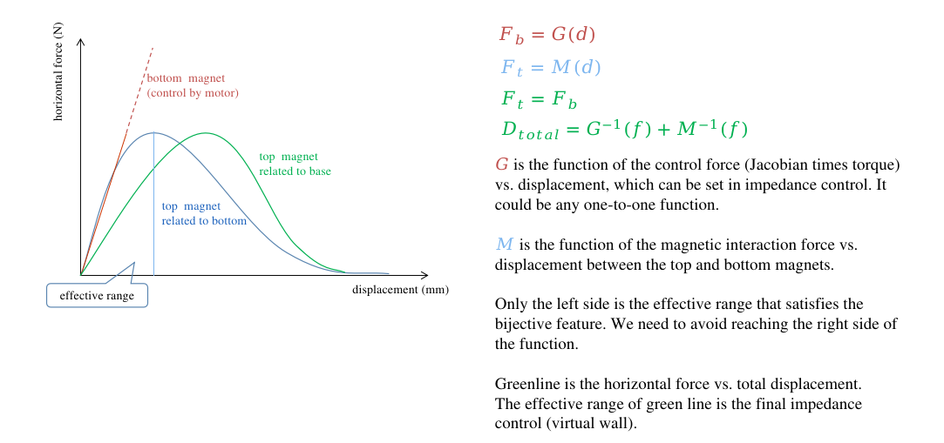
Control System: Control Theory – Passive
Notes:
Lio

Slide 23
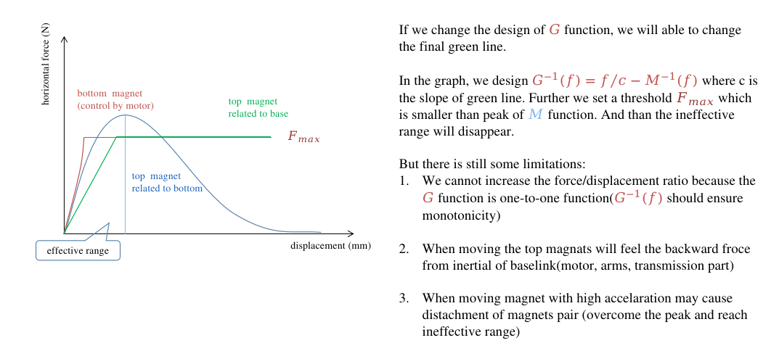
Control System: Control Theory – Passive
Notes:
Lio

Slide 24
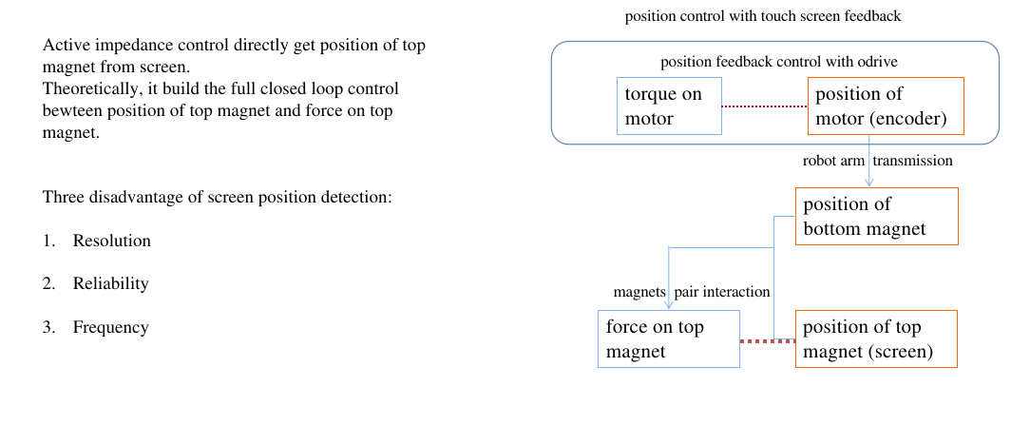
Control System: Control Theory – Active

Slide 25
Reference Slides

Slide 26
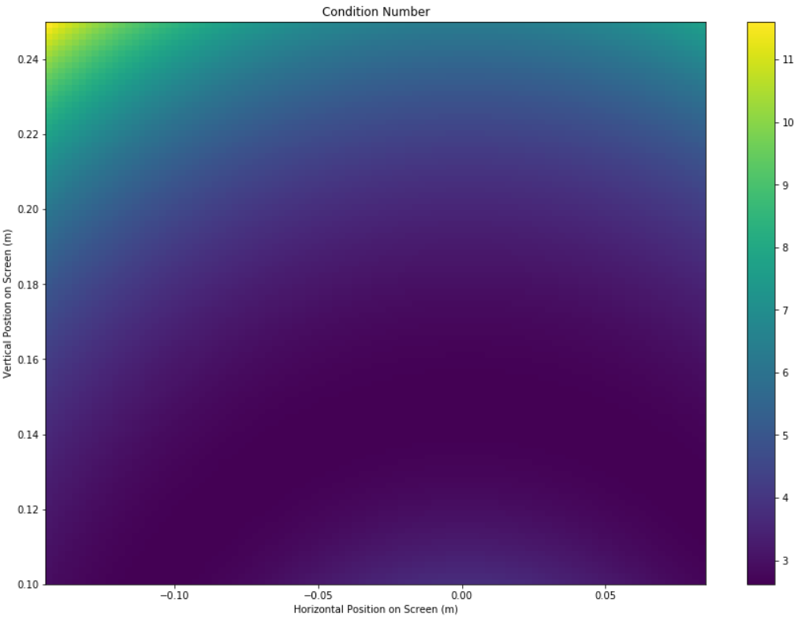
Condition Number Plot
*For right linkage

Slide 27
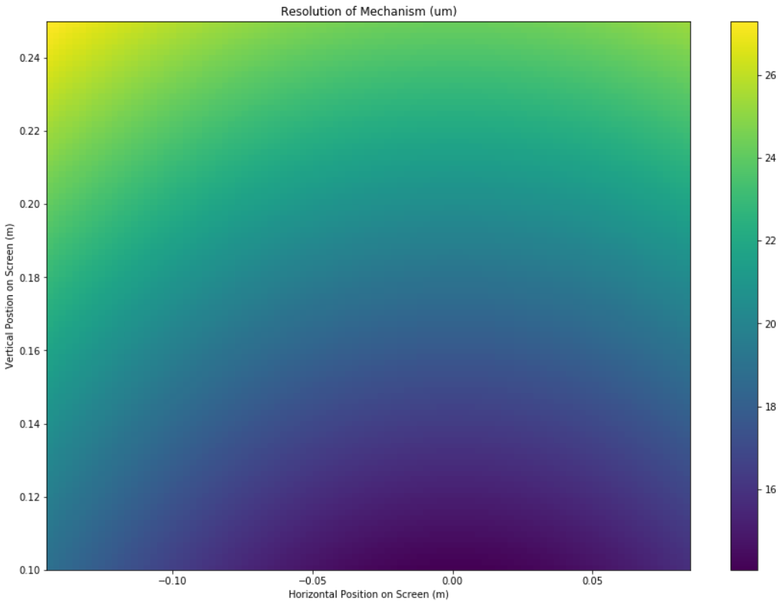
Resolution Plot
*For right linkage

Slide 28
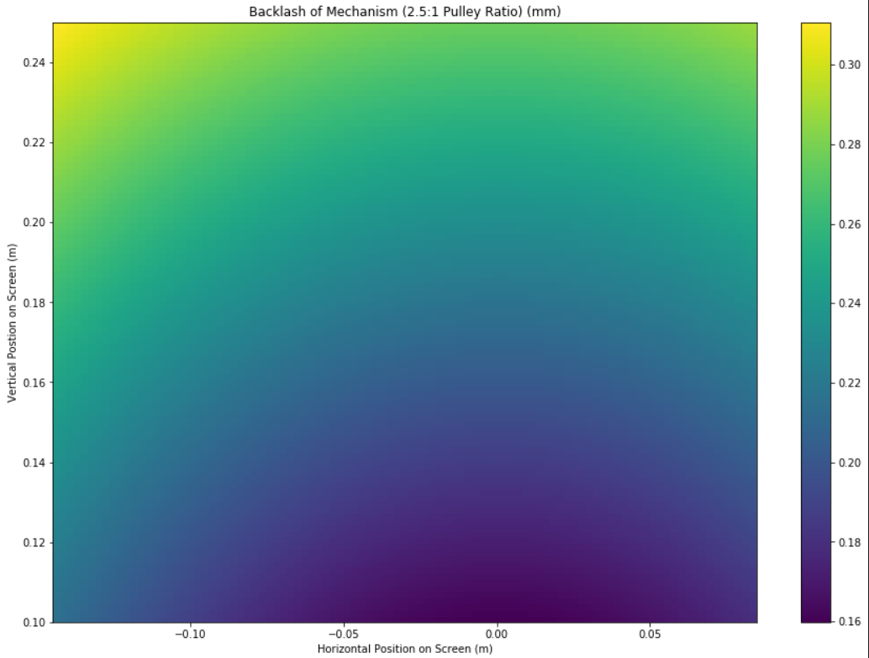
Backlash Plot
*For right linkage

Slide 29
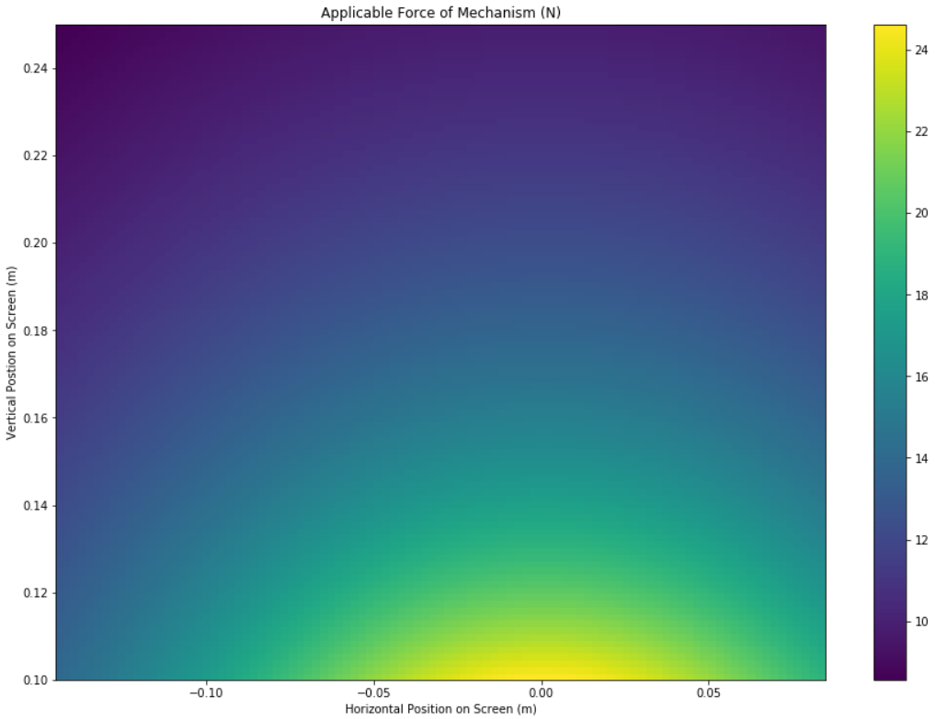
Force Plot
*For right linkage

Slide 30
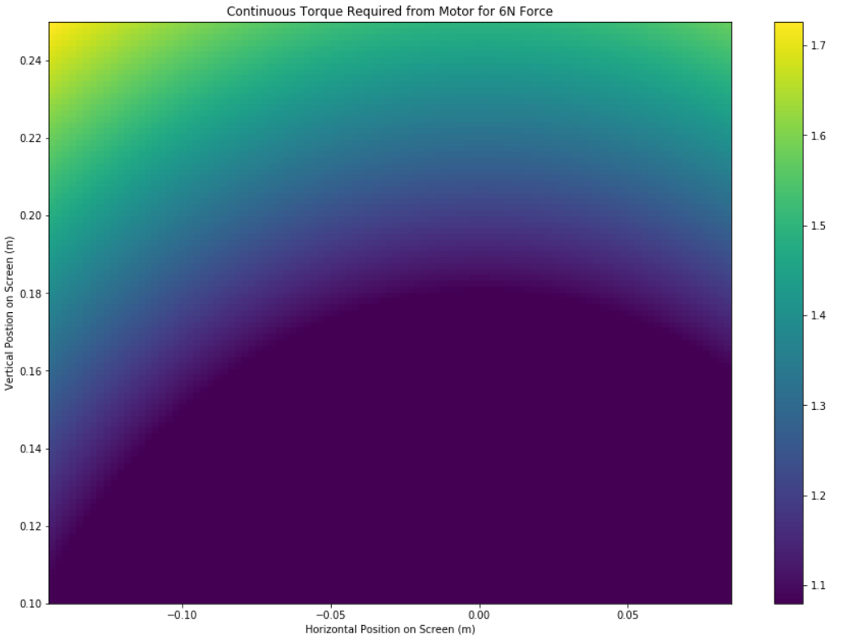
Torque Plot
*For right linkage

Slide 31
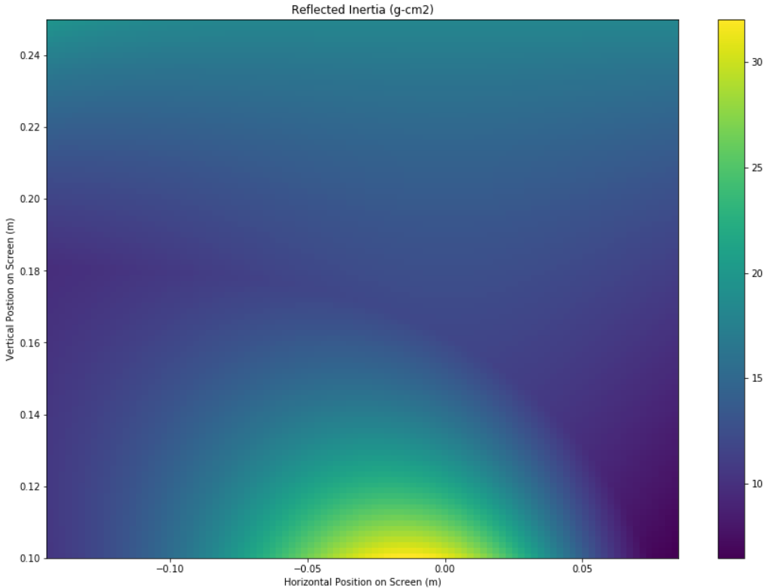
Reflected Inertia Plot
*For right linkage

